Slide 1

Proyecto Hipotético
Análisis de Ventas

Slide 2

Executive Summary
The objective of this document is to present a hypothetical survey data analysis project, developed with the purpose of demonstrating proficiency in data cleaning, exploration, and visualization through the use of specialized analytical tools.
For the execution of this project, the following technologies were used:
R (RStudio): For data cleaning, transformation, and initial exploration. This included identifying and handling missing values, standardizing variable formats, and performing descriptive statistics to better understand respondent behavior.
Tableau: For creating dynamic visualizations that highlight key patterns, such as demographic distributions, satisfaction levels, and trends segmented by country or other variables of interest.
This analysis offers insights into participant responses and satisfaction levels, helping to identify patterns and relevant group differences within a simulated survey context. The combination of R and Tableau ensures both depth in the analysis and clarity in the visual communication of findings.

Slide 3
1
Methodologies Employed

Slide 4




Let's understand the methodologies with which we generate the results...
Data Wrangling (Data Exploration and Cleaning)
Exploratory Data Analysis (EDA)
Modelación y visualización interactiva
Insights generation
Tool: R
Techniques were applied to correct missing or inconsistent data, standardize column names and transform categorical variables to facilitate their analysis.
Initial descriptive analysis was also used to detect errors and understand the basic structure of the data.
Tool: R
Through graphs and descriptive statistics, relevant patterns were identified, such as distribution by country, age and level of satisfaction.
This allowed us to generate hypotheses and observe possible relationships between variables.
Tool: Tableau
Dashboards and dynamic graphs were built to visualize the information in a clear and understandable way.
Segmentation by key variables such as country, age or satisfaction allowed for a more in-depth and decision-oriented reading.
Tools: R and Tableau
From the visual analysis and statistical summaries, key trends were identified, such as the countries with the highest participation or the profiles with the highest levels of satisfaction.
Strategic recommendations were established based on these findings.

Slide 5
2
About the Analysis…

Slide 6
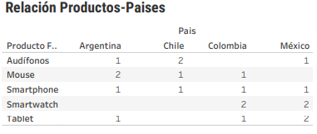

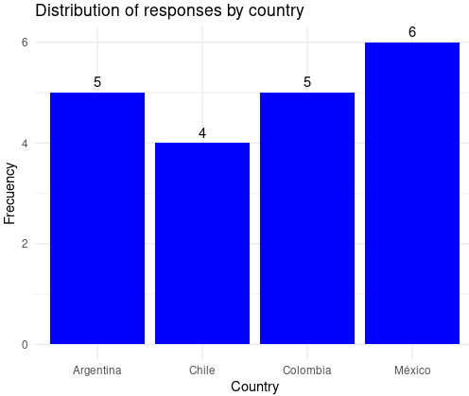


The survey was carried out in the 4 main sales countries for electronic devices.
The main countries were Argentina, Chile, Colombia and Mexico, when we found in first place the number of responses from each country with a small difference in Mexico and interaction in Chile.
In this survey we can define the interactions according to the different products that customers buy, and give us their opinions of these products.
Finally we can define the volume of responses according to the products and the numbers of the opinions of these devices.

Slide 7
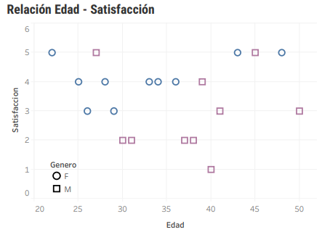
We identified a higher level of satisfaction in the age ranges between 20-30 years and 40-45 years, in both genders.
What we know…
We know that the lower age range of 20 to the mid-point of 25 to 30 years old, are the first group that reflects greater satisfaction in the products they purchased, as well as the range between 40 to 45 years old.
On the other hand, consumers in their mid-30s to 40s are the group with the lowest purchase satisfaction.
Within the above range we can highlight that among both genders those who maintain the lowest satisfaction scale are women; on the other hand, men maintain a regular scale.

Slide 8
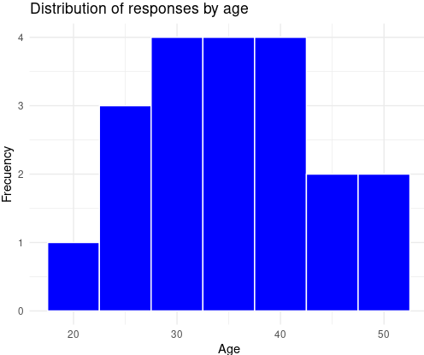
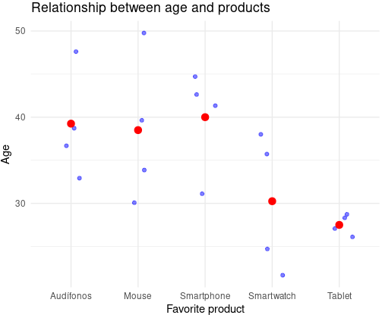
We identified a higher level of satisfaction in the age ranges between 20-30 years and 40-45 years, in both genders.
First of all, the highest concentration of purchases is found in the regularly satisfied population in the 30-40 age range.
The regularly satisfied population represents just over 50% of customers to date.
Consumption in the 30-40 age range focuses on Mouse, Headphones and Smartphones products.
Younger age groups focus their consumption on smartphones and tablets.

Slide 9
3
Recommendations

Slide 10

Understanding the data, we can recommend...
1
First of all, the lack of satisfaction within the 30-40 years age range should be investigated, since they represent 50% of the net purchases that are made, having as main focus, the devices purchased: Smartphones, Headphones and Mouse.
2
In the smartphone category, it is necessary to compare the appeal of the younger clientele in contrast to the previous range, in order to mark the differences between the consumer experiences and refine these devices for each segment.
3
It is important to extend the commercial strategies to the 20-30 and 40-45 age ranges, since they reflect a better purchase satisfaction, as opposed to the intermediate range of 30-40 years old.

Slide 11
4
Appendix

Slide 12
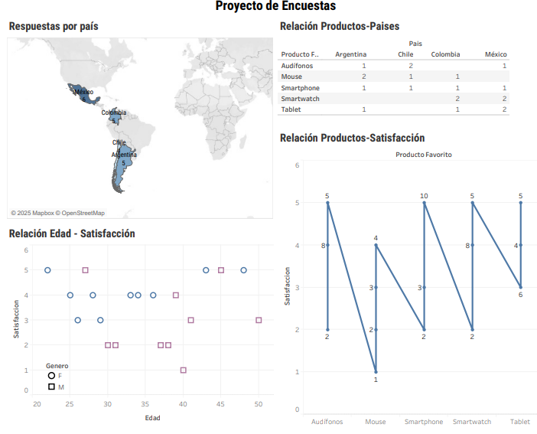
Dashboard with additional data

Slide 13




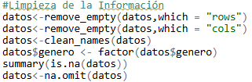

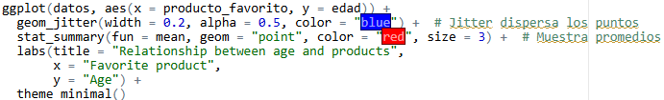
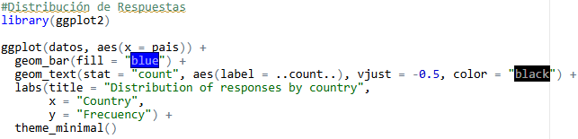
Work codes in R

